Slide 1
PL/SQL

Slide 2
PL/SQL
PL/SQL (Procedural Language / SQL) extends SQL by adding programming constructs:
  variables
  types
  control structures (if, loop)
  Subprograms
PL/SQL Block:
  The basic unit of PL/SQL is a block
  Blocks can be nested.
  Typically each block performs a logical unit of work.
  Block structure is (boldfaced part required):
    DECLARE
    declaration section
    BEGIN
    executable section
    EXCEPTION
    error handling section
    END;

Slide 3
Execution section : starts with the reserved keyword BEGIN and ends with END
It’s a mandatory section and holds the program logic.
Begin Section: ALL manipulation commands for assignment,branches,loops,triggers are specified here.
DDL is not allowed here
END section: Marks the end of PL/SQL block.
Exception: optional ,any error that occur in the program are handled in this section.

Slide 4
PL/SQL Data Types
Number(n,m)
Char(n)
Varchar2(n)
Date
Long
Raw
Blob
Bfile
e.g: Productprice number := 0
Scope of Variable
Local : Declare in an inner code block and cannot be
referenced by outer code block.
Global : declare in an outer code block and can be
referenced by inner code block.
To display message
Set serveroutput [ON|OFF]
Set serveroutput on size 30000

Slide 5
Record Data Type
Composite data type
TYPE customers is record
  (custid number(20),
  Custname varchar(20));
%type is useful if varaible of record is based on a column from an already existing database table
TYPE customers is record
  (custid customers.custID%TYPE,
  Custname customers.custname%TYPE);
If all fields of a record are based on all columns of a table
  typcustomer customer%ROWTYPE;

Slide 6
Assigning values to record
<recordname>.<columnname>:=<value>
If we have used rowtype ,
Select * into <recordname> from <tablename> where <condition>

Slide 7
Control statment
Condition
Iterative
Sequential

Slide 8
Conditional statement
If < condition> then
  <action>
ElseIF<condition> then
  <action>
ELSE
  <action>
END IF;

Slide 9
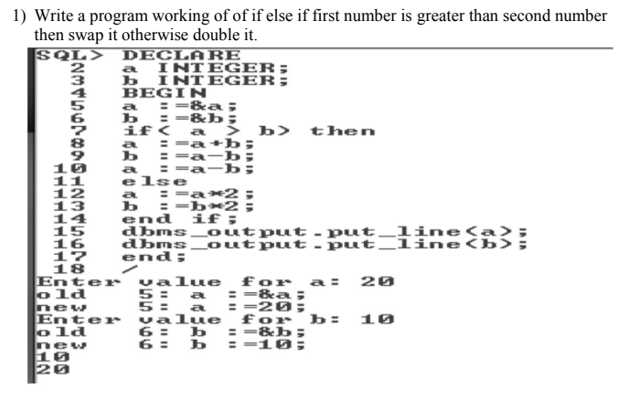
Conditional Satment

Slide 10
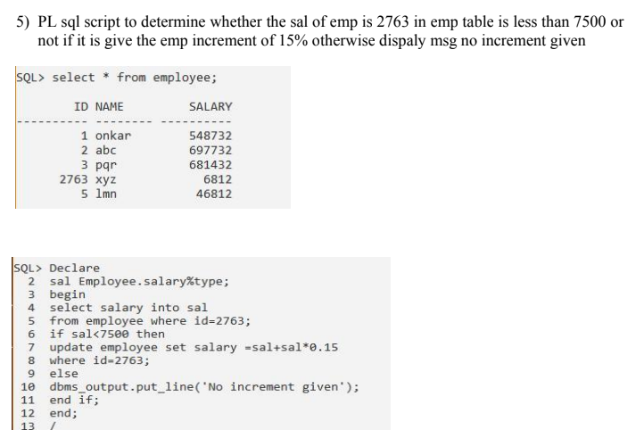

Slide 11
Iterative
Simple Loop
While Loop
For Loop

Slide 12
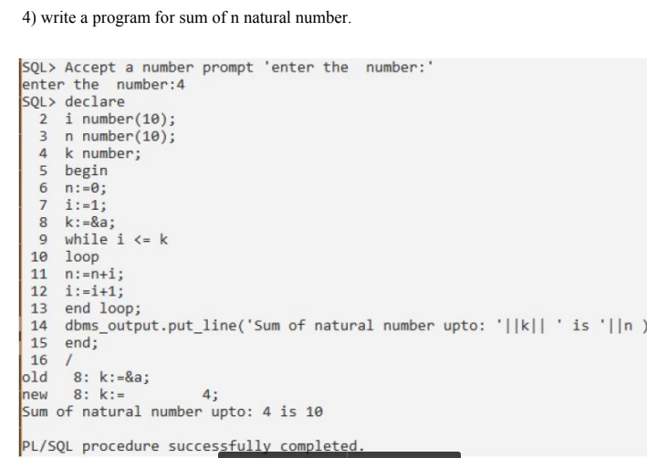

Slide 13
cursors
Oracle create a certain portion in the memory for every SQL query that is executed.
Using PL/SQL this portion in the memory can be given a name of choice (called cursor or context area).
A cursor is basically a pointer to the context area and thus represent a structure in memory.
Cursor are usually used to hold the data retrieved from tables and perform action on the data one row at a time.
Two Types
  Implicit: oracle opened for internal processing
  Explicit

Slide 14
Cursor attribute
%isopen
%found
%notfound
%rowcount

Slide 15
Explicit Cursor
Cursor that is explicitly opened for processing data using PL/SQL block.
Declared in the DECLARE section of PL/SQL
CURSOR <cursor name> is<SELECT Query>
BEGIN
  OPEN <cursor name>
  Fetch Records
FETCH commands can be placed inside LOOP.

Slide 16
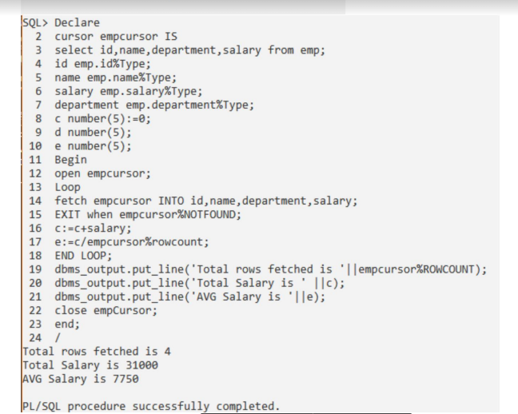
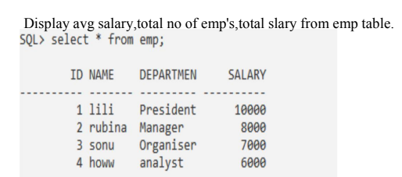

Slide 17
Questions
To give raise to all employees earning salary less than 1500.
To set job of all clerks with salary greater than 1300 as “Senior
Clerk”

Slide 18
Trigger
A trigger is a piece of code spec that is run before or after a database table is modified.
A trigger can be defined on:
  TABLES/VIEWS:DML [Insert/update/Delete]
  Schema : DDL Trigger and Logon/Logoff
  Database: system event triggers [startup/shutdown]
A trigger is used to:
  Prevent invalid transaction.
  Keep an audit trail of a table
  Ensure rollback if database found inconsistent.

Slide 19
Parts of Trigger
Trigger Statement : Trigger fires automatically when any of following events occur
  Insert,Update or Delete statement on table or view.
  Create,Alter or Drop statement on Schema Object
  Database startup or shutdown
Trigger Restriction : Boolean expression that must be TRUE for trigger to fire.(where clause)
Trigger Action: code spec to be executed when the trigger fires.

Slide 20
Types of Triggers
Row Trigger : fired each time a row in the table is affected. It uses FOR EACH ROW clause.
Statement Triggers: Fired once on behalf of the triggering statement, independent of the number of rows the triggering statement affects.[even if no rows are affected]
Timed Triggers: Before/After Triggers (insert ,update or delete operations that occur on table)
Instead of: Transparent way of modifying a view that cannot be modified directly through DML.

Slide 21
Create Trigger
CREATE [OR REPLACE ] TRIGGER trigger_name
{BEFORE | AFTER | INSTEAD OF }
{INSERT [OR] | UPDATE [OR] | DELETE}
[OF col_name]
ON table_name
[REFERENCING OLD AS old NEW AS new]
[FOR EACH ROW]
WHEN (condition)
DECLARE
Declaration-statements
BEGIN
Executable-statements
EXCEPTION
Exception-handling-statements
END;

Slide 22
Create Trigger
CREATE [OR REPLACE] TRIGGER trigger_name − Creates or replaces an existing trigger with the Trigger name.
{BEFORE | AFTER | INSTEAD OF} − This specifies when the trigger will be executed. The INSTEAD OF clause is used for creating trigger on a view.
{INSERT [OR] | UPDATE [OR] | DELETE} − This specifies the DML operation.
[OF col_name] − This specifies the column name that will be updated.

Slide 23
Create Trigger
[ON table_name] − This specifies the name of the table associated with the trigger.
[REFERENCING OLD AS o NEW AS n] − This allows you to refer new and old values for various DML statements, such as INSERT, UPDATE, and DELETE.
[FOR EACH ROW] − This specifies a row-level trigger, i.e., the trigger will be executed for each row being affected. Otherwise the trigger will execute just once

Slide 24
Create Trigger
when the SQL statement is executed, which is called a table level trigger.
WHEN (condition) − This provides a condition for rows for which the trigger would fire. This clause is valid only for row-level triggers.

Slide 25
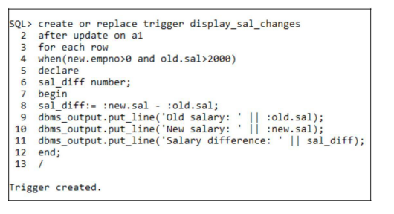
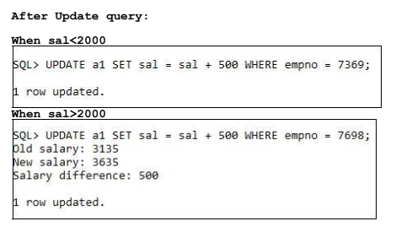
Create a trigger that fires on emp (a1) table after update of salary when sal>2000.It should display old salary, new salary and difference.

Slide 26
Note: Mutation Error
When row-level trigger accesses the same table on which it is based while executing.
The table is said to be mutating

Slide 27
Questions Trigger
Create a trigger that fires before insert or delete of a row in emp table and displays the count of rows.
Create a trigger that stops user from entering Dept no in emp table if that dept no doesn’t exist in dept table. Trigger should display the contents of dept table.

Slide 28
Procedure and Functions
PL/SQL allows writing sub programs (named code block made up of logically grouped SQL and PL/SQL statement)
Procedure and Functions
  Procedure may return one or more values through parameters or may not return values at all.
  Function always return a value using the return statement.(one value)
  DML statements cannot be used in functions.
  A select SQL Query can call a function.
  A Select SQL Query cannot call a procedure.
If we want to update emp sal a procedure is preferred.
Retrieve information function is preferred.

Slide 29

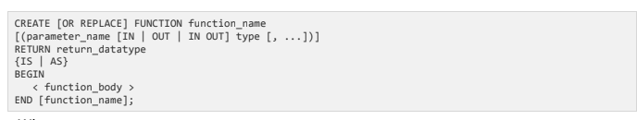
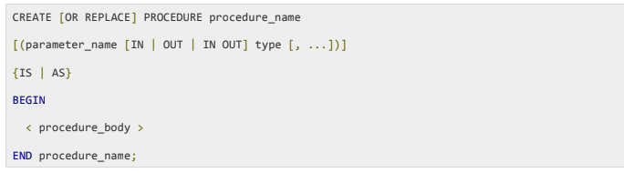
Syntax function and procedure

Slide 30
e.g 1
Create a procedure that:
Accepts employee number as a parameter
Calculates the number of leaves from the data available in employee muster
Provides the updated number of leaves as a value

Slide 31
Solution
Create or replace procedure calculateempleave(
Varempno IN varchar2,varleaves OUT Number)IS
BEGIN
select count(*) into varleaves from employeemuster
Where empid=varempno and attendance <> ‘present’;
END;

Slide 32
TEST the procedure sql/plsql
EXEC calculateempleaves(4,:varnoofleaves);
print varnoofleaves;

Slide 33
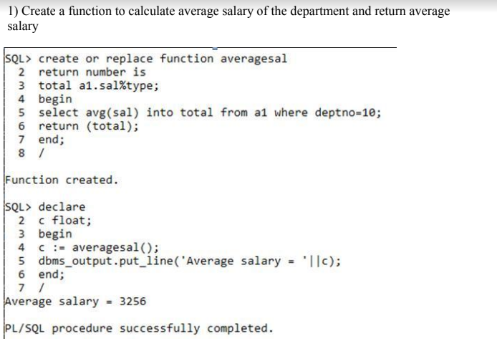

Slide 34
Questions
Write a procedure that:
  Accepts department number and percentage of raise in sal
  Updates the sal of all those employee under that department
Write a function that accepts :
  Dept no and returns total sal of all employees in that department.

